Slide 2
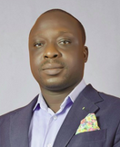



Position | Managing Partner / BI Developer @ Jireh Computers
Qualifications and Experience | A Computer Science Graduate and a Microsoft Evangelist on Data Science and Cloud Technology. A Microsoft Certified Trainer & Microsoft Most Valuable Professional with over 23 years training individuals on Spreadsheet/BI Applications for Business Reporting. Trained over 200,000 participants around the globe Over the course of his career, Ayodeji has gained the following professional titles: Microsoft Certified Professional (Office, SQL Server, Power BI) Project Manager, System/Business Analyst Data Warehouse & Business Intelligent Consultant Dashboard Reporting Expert
Ayodeji Folarin MVP, MCT, MBA
Dejifolarin.com
@Deji_Folarin
Ayodeji Folarin

Slide 3
AI in Power BI
AI Transformers
AI Visuals

Slide 4
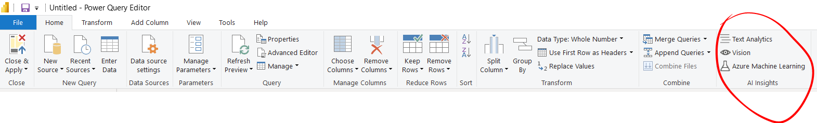
AI Transformers
Text Analytics
Detect Language
Extract Key Phrases
Score Sentiment
Vision
Tag Image
Azure Machine Learning

Slide 5
AI Visuals
Q & A
Key Influencers
Decomposition Tree
Smart Narrative / Summary

Slide 6
AI Visuals
Anomalies
Analyze (Distribution Change / Explain Change)
Clustering
Quick Insight

Slide 7


